Slide 1
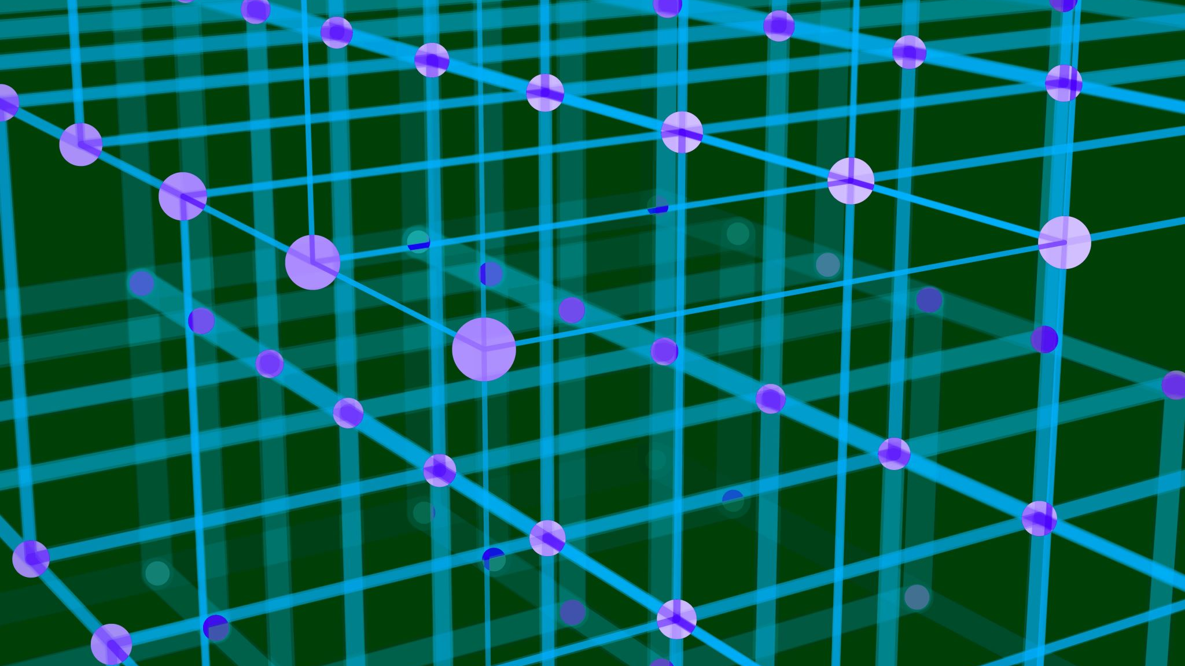
Autonomous
The final frontier

Slide 2

What is autonomous?
Autonomous mode takes place in the first 15 seconds of an FRC match. During autonomous mode, robots operate via preprogrammed instructions. There are several tools we use to make this easier on ourselves, but in this lesson, we’ll just cover the basics.

Slide 3
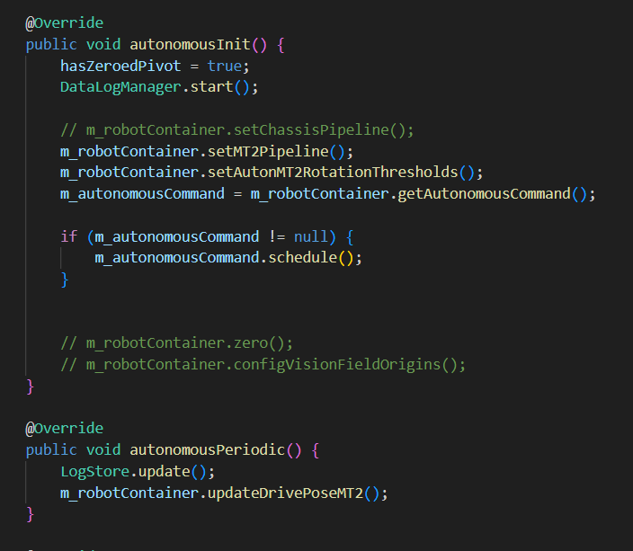
Autonomous in Robot.java
Just like teleoperated, Robot.java contains methods for autonomous. They work in exactly the same way, with an “init” method to run once on auton enable and a “periodic” method to run once every tick during auton.

Slide 4
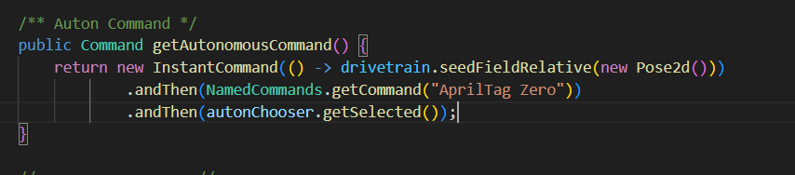
Autonomous with subsystems
Using subsystems and the command-based structure of WPILib, auton routines are controlled via commands. Typically, the autonomous command is passed in through the “getAutonomousCommand” method in RobotContainer.java. This command can include functionality from many subsystems,and is typically sequenced via PathPlannerLib and selected with an autonChooser.

Slide 5

Making an auton
In this lesson, we’ll focus on the first method of making autons, using the methods in Robot.java. As an example, we can use the code from the last lesson

Slide 6

Making an auton (cont.)
In the class, we can make a new method that returns a command. In this method, we can specify an autonomous sequence to spin the motor around a couple times. To start, lets define the method.

Slide 7

Making an auton (cont.)
Next, we will add the functionality. For this example, we will spin the motor forward for 2 seconds and then backward for 3. Let’s start by spinning the motor forward for 2 seconds. To make it last for two seconds, we can turn it into a repeat command with .repeatedly() and then add a timeout with the .withTimeout(double seconds) decorator.

Slide 8

Making an auton (cont.)
Next let’s add spinning backward for 3 rotations. We will use the .andThen(Command command) decorator to add another command to the back of the command we just made:

Slide 9

Making autons (cont.)
Finally, we must set the command in the getAutonomousCommand in RobotContainer.

